Slide 1




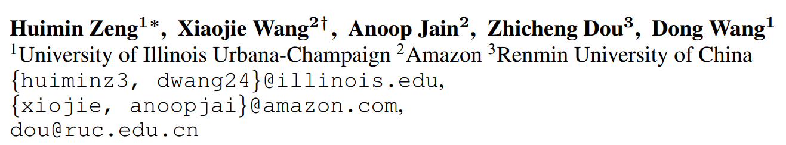





ATAI
Advanced Techniqueof Artificial Intelligence
ATAI
ChongqingUniversity _{AdvancedTechniqueof}
of Technology Artificial Intelligence
Chongqing University of
Technology
Chongqing University ^{ATAI}
_{of Technology} Advanced Techniqueof
Artificial Intelligence
Chongqing University of Technology
Chongqing University of Technology
  A Non-Contrastive Learning Framework for Sequential Recommendation with Preference-preserving Profile Generation
Code: https://github.com/huiminzeng/NCL-SR.git
2025.6.8•ChongQing
—— ICLR 2025
Reported by Shunan Yin
1

Slide 2

ATAI
AdvancedTechniqueof
Artificial Intelligence
ATAI
ChongqingUniversity _{AdvancedTechniqueof}
of Technology Artificial Intelligence
ChongqingUniversity of Technology
Motivation
i) CL suffers from high computational costs due to its reliance on negative samples and is sensitive to data
augmentation.
ii) Augmentation operations of CL-based methods may also introduce preference inconsistency in the positive samples, because they may fail to preserve user preferences.
iii) NCL’s effectiveness for SR is unexplored.

Slide 3

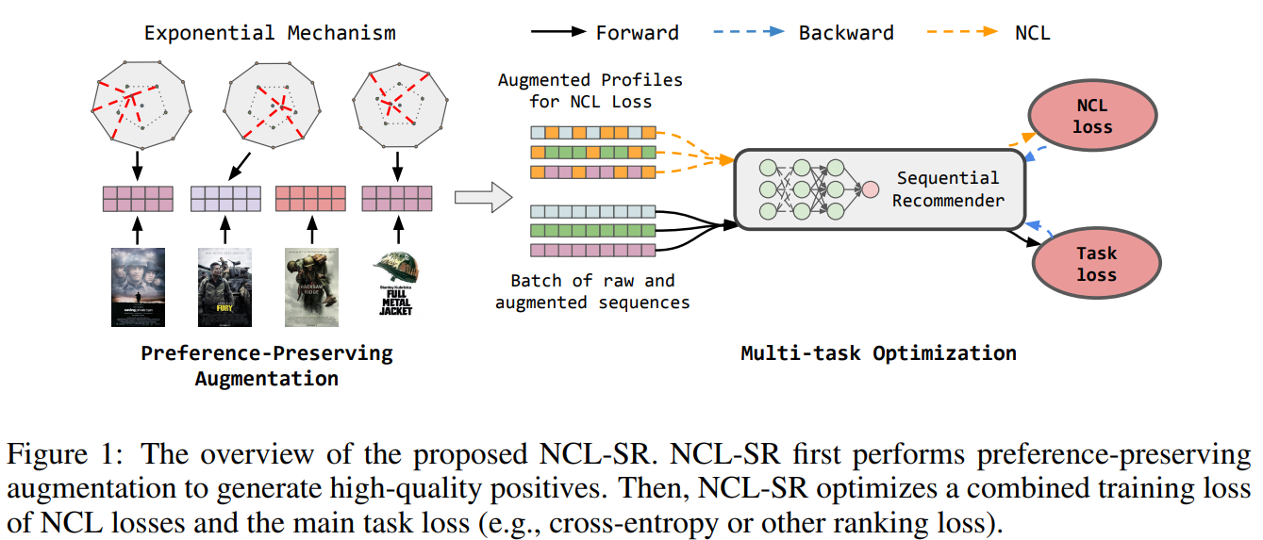
ChongqingUniversity of Technology
ATAI
AdvancedTechniqueof
Artificial Intelligence
ATAI
ChongqingUniversity _{AdvancedTechniqueof}
of Technology Artificial Intelligence
Overview

Slide 4

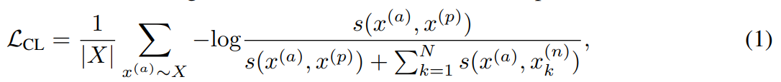
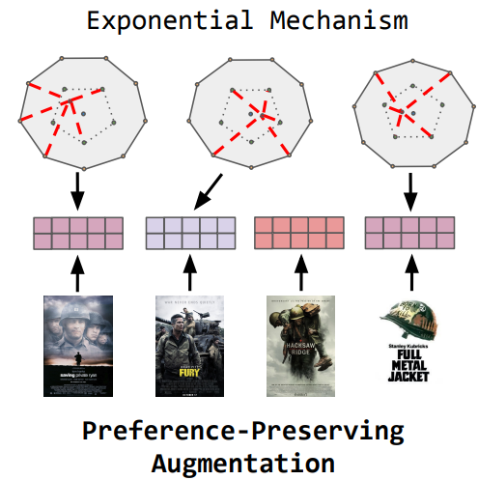
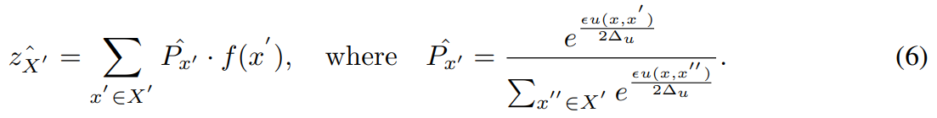
ChongqingUniversity of Technology
Method
ATAI
AdvancedTechniqueof
Artificial Intelligence
ATAI
ChongqingUniversity _{AdvancedTechniqueof}
of Technology Artificial Intelligence

Slide 5
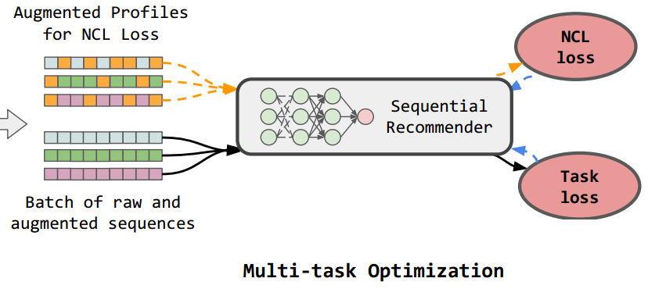
ChongqingUniversity of Technology
Method
ATAI
AdvancedTechniqueof
Artificial Intelligence
ATAI
ChongqingUniversity _{AdvancedTechniqueof}
of Technology Artificial Intelligence

Slide 6

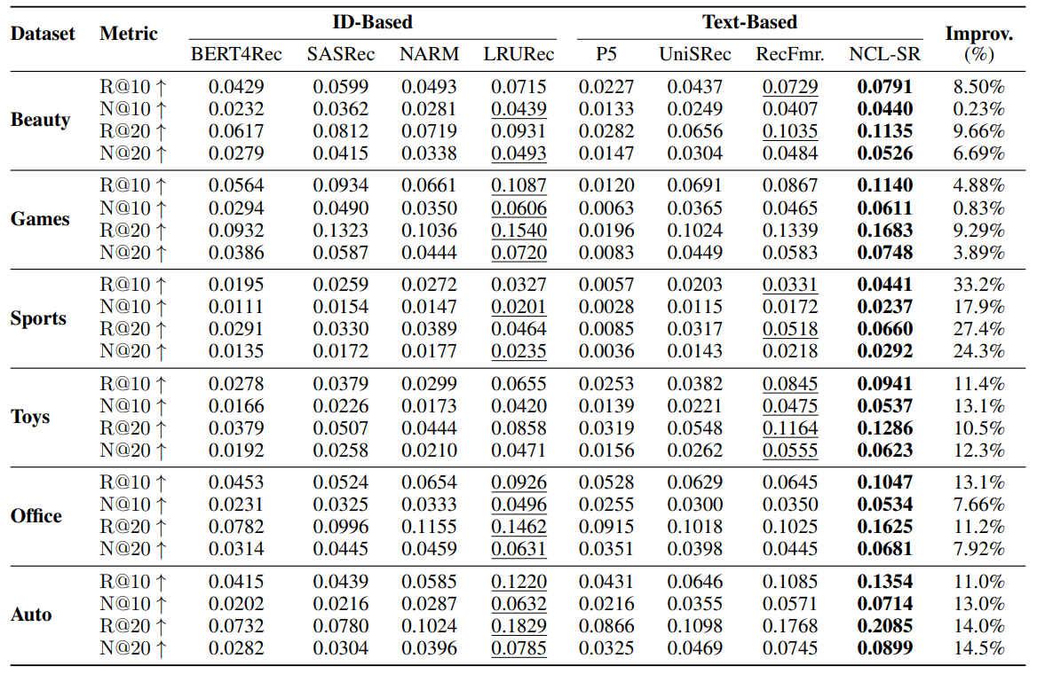
ATAI
AdvancedTechniqueof
Artificial Intelligence
ATAI
ChongqingUniversity _{AdvancedTechniqueof}
of Technology Artificial Intelligence
ChongqingUniversity of Technology
Experiments

Slide 7
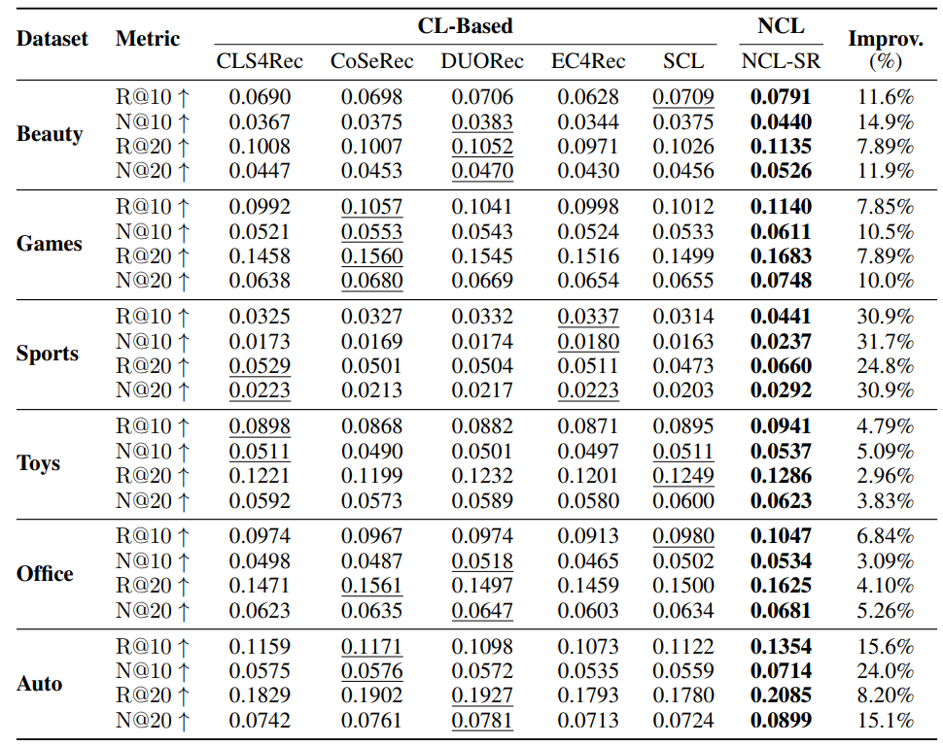
ATAI
AdvancedTechniqueof
Artificial Intelligence
ATAI
ChongqingUniversity _{AdvancedTechniqueof}
of Technology Artificial Intelligence
ChongqingUniversity of Technology
Experiments

Slide 8
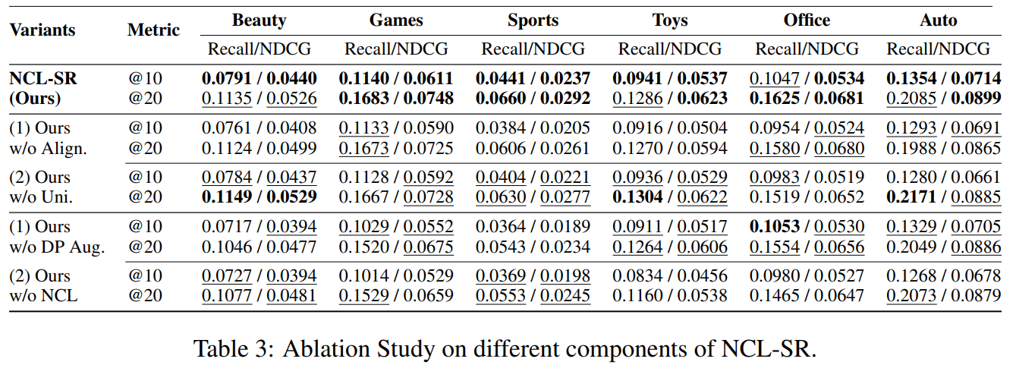
ATAI
AdvancedTechniqueof
Artificial Intelligence
ATAI
ChongqingUniversity _{AdvancedTechniqueof}
of Technology Artificial Intelligence
ChongqingUniversity of Technology
Experiments

Slide 9
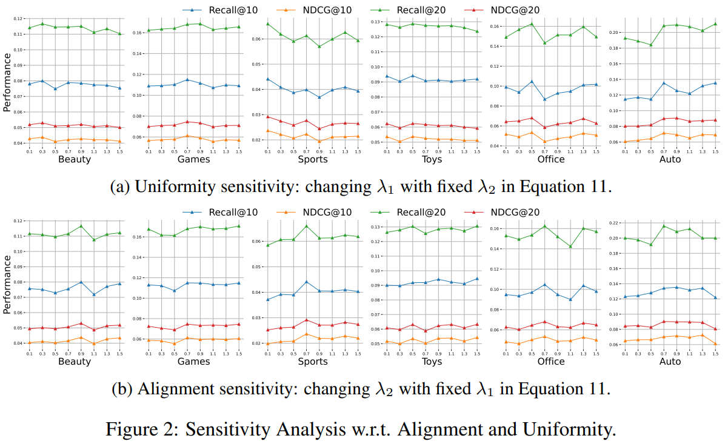
ATAI
AdvancedTechniqueof
Artificial Intelligence
ATAI
ChongqingUniversity _{AdvancedTechniqueof}
of Technology Artificial Intelligence
ChongqingUniversity of Technology
Experiments

Slide 10


ChongqingUniversity of Technology
ATAI
AdvancedTechniqueof
Artificial Intelligence
ATAI
ChongqingUniversity _{AdvancedTechniqueof}
of Technology Artificial Intelligence
Thanks!

